Slide 1
Stage Report
VE490 INDOOR LOCALIZATION
Tianyu Wang
Oct 11th , 2018

Slide 2

Contents
Contents
General Direction
Paper Reading
Result Reproducing
2

Slide 3
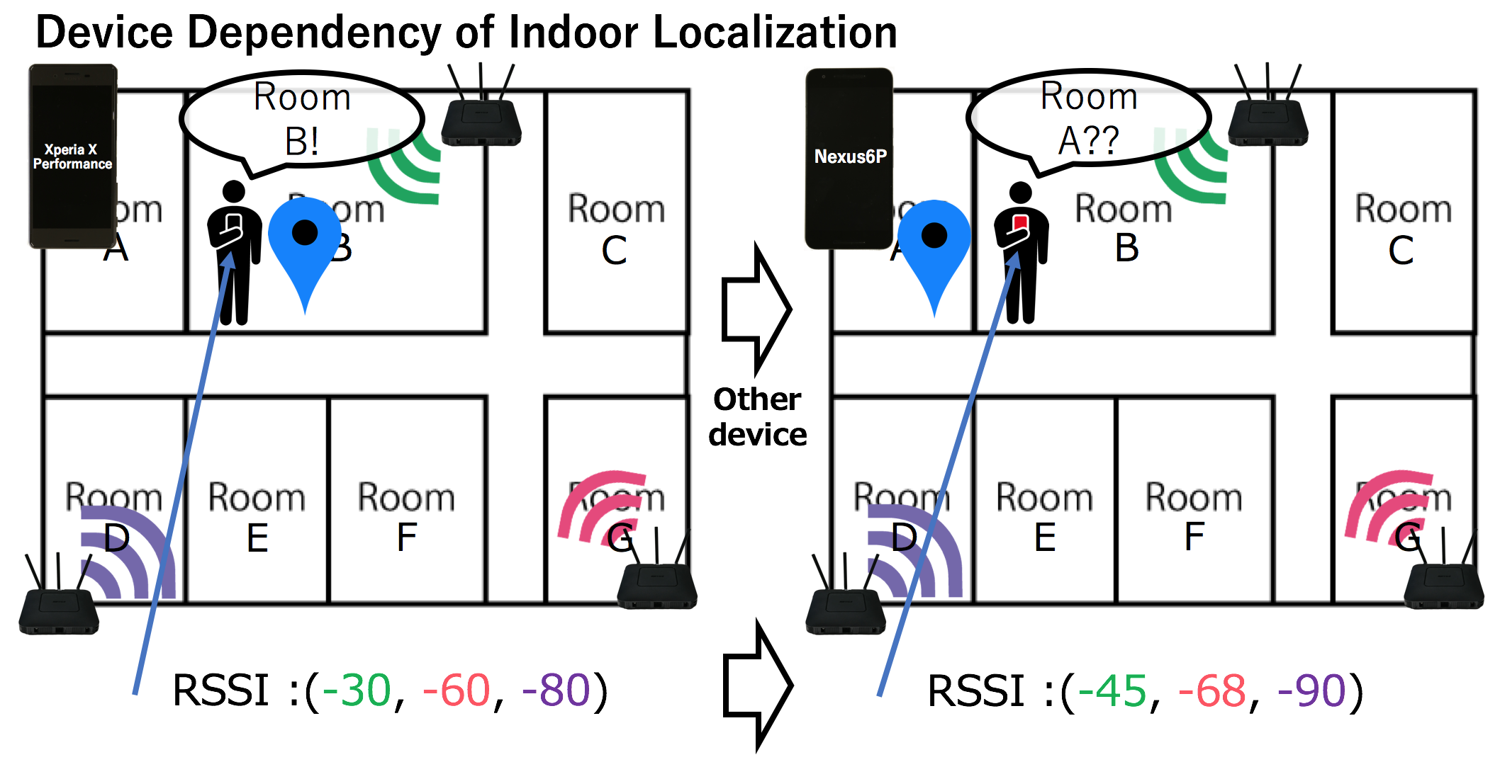
General Direction
Indoor Localization: locate objects or people inside a building
using sensory information collected by mobile devices.
Major Focus: direct localization based on fingerprinting before
beam alignment
Limited number of access points
The spatial coordinates
Moving objects
Poor accuracy
3

Slide 4
Existing Solutions
Limited number of access points
The spatial coordinates
Data Augmentation
Exploit more diverse fingerprinting features at each access point
Direct division of grid in the target space (not feasible when the space is large and accuracy is strictly required
Divide into Building/Floor/Location structure
4

Slide 5
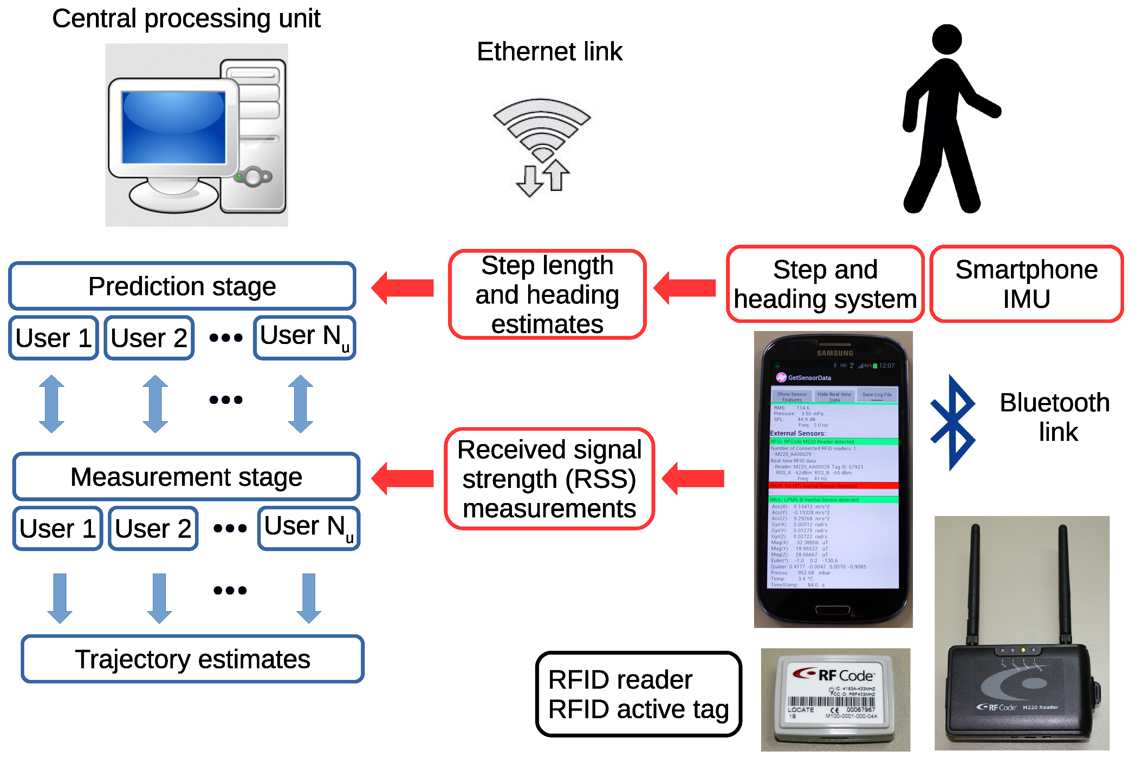
Existing Solutions
Moving Objects
Poor Accuracy
Make use of smartphone built-in IMU sensors: accelerometers, gyroscope, compass
Generally meter-level mean error and worst error
Error is often measured as the form of CDF
5

Slide 6
Paper [1]
A Scalable Deep Neural Network Architecture for Multi-Building and Multi-Floor Indoor Localization Based on Wi-Fi Fingerprinting
An earlier version of this paper was presented in part at ICUMT/FOAN 2017, Munich, Germany, November 2017.
International Congress on Ultra Modern Telecommunications and Control System
International Workshop on Fiber Optics on Access Network
6

Slide 7
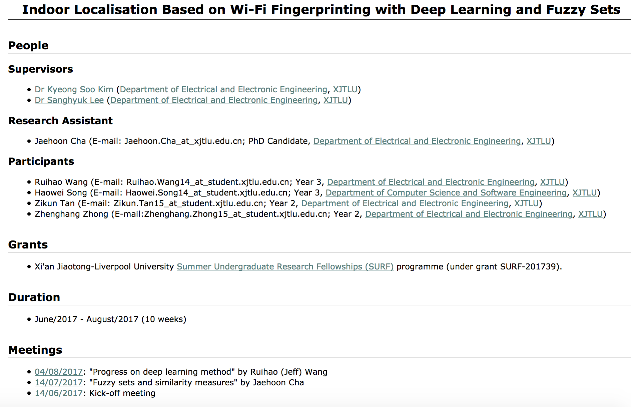
Paper [1]
7

Slide 8
Motivation
Existing Problem: large-scale location-aware services covering a complex of multi- story buildings (e.g., shopping mall).
-> The hierarchical structure : building / floor / 2D coordinates
-> NLOS condition stronger
-> AP scarce ( because the purpose of these spots is not to provide indoor localization)
Call for Scalability: Scalability is an attribute that describes the ability of process,
network, software or organization to grow and manage increased demand. A system,
business or software that is described as scalable has an advantage because it is more
adaptable to the changing needs or demands of its users or clients.
8

Slide 9
Existing Solutions
Existing Solution: divide the hierarchical structure into parts and conquer each part using tailored algorithm.
One measured fingerprint (RSS1, RSS2, RSS3,…), find the AP corresponding to the strongest RSS, then build a subset of fingerprints where the same AP has the strongest RSS, then count the number of fingerprints associated with each building and set the estimated building to be the most frequent one. Follow the same procedure to floor. Coordinates would then be calculated based on the belonging similar points.
Divide the huge space into small grids, and set up the label for each grid. In the online stage, the grid number is predicted using fingerprinting. The coarse location information is than refined using methods like Hidden Markov Model.
9

Slide 10
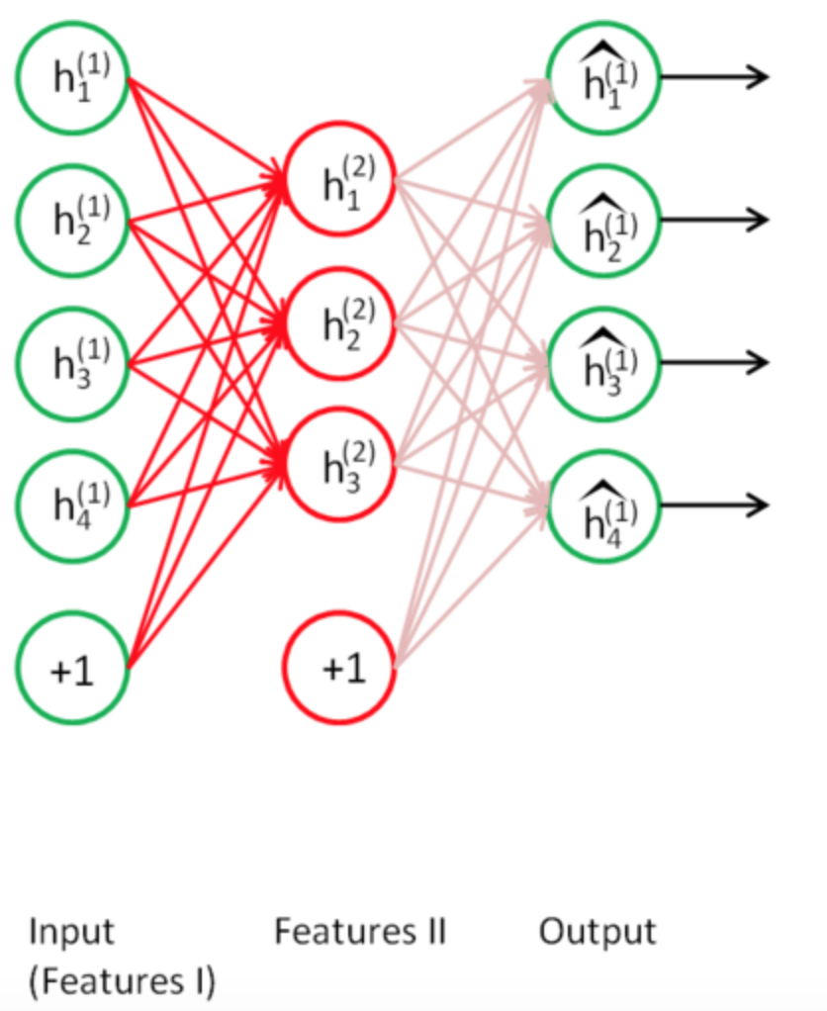
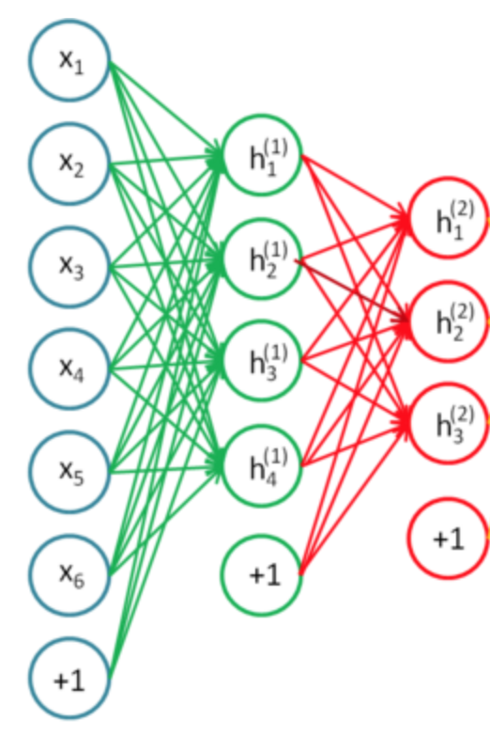
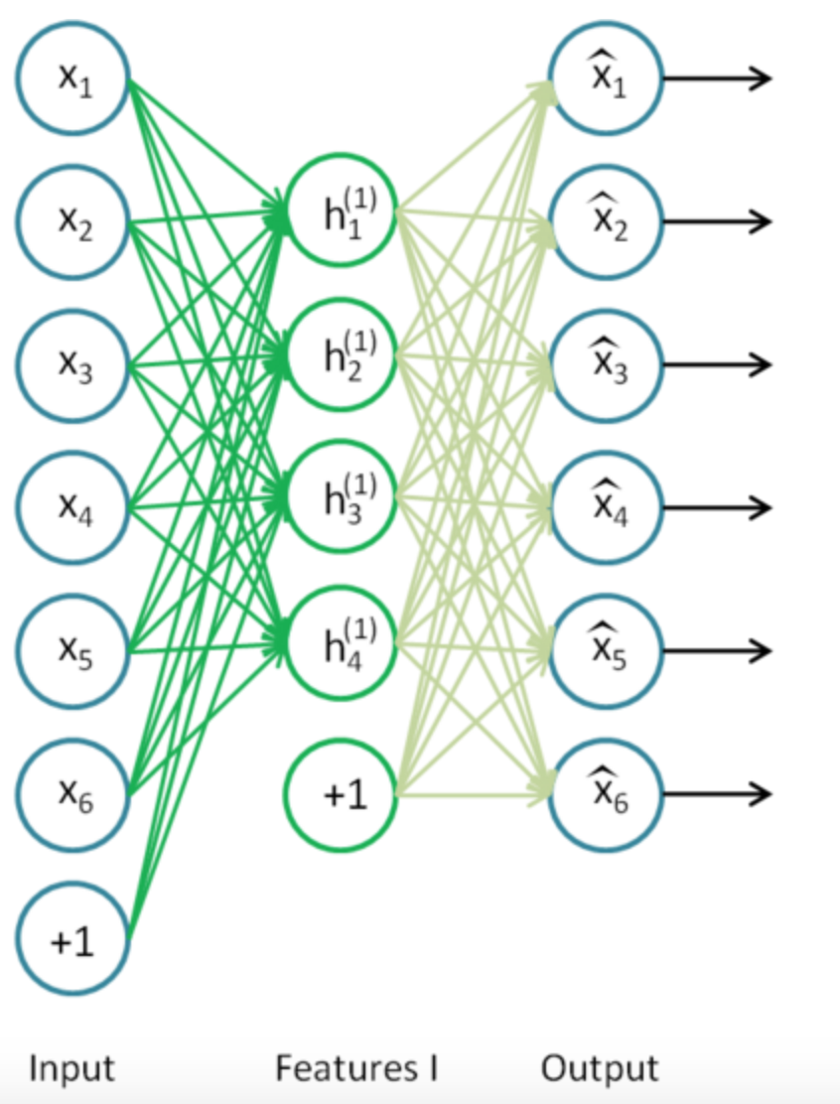
Methodology
RSSI values collected from each Access Point form the fingerprinting features.
Input sent to Stack Autoencoder (SAE) first to grab the compact features.
10

Slide 11
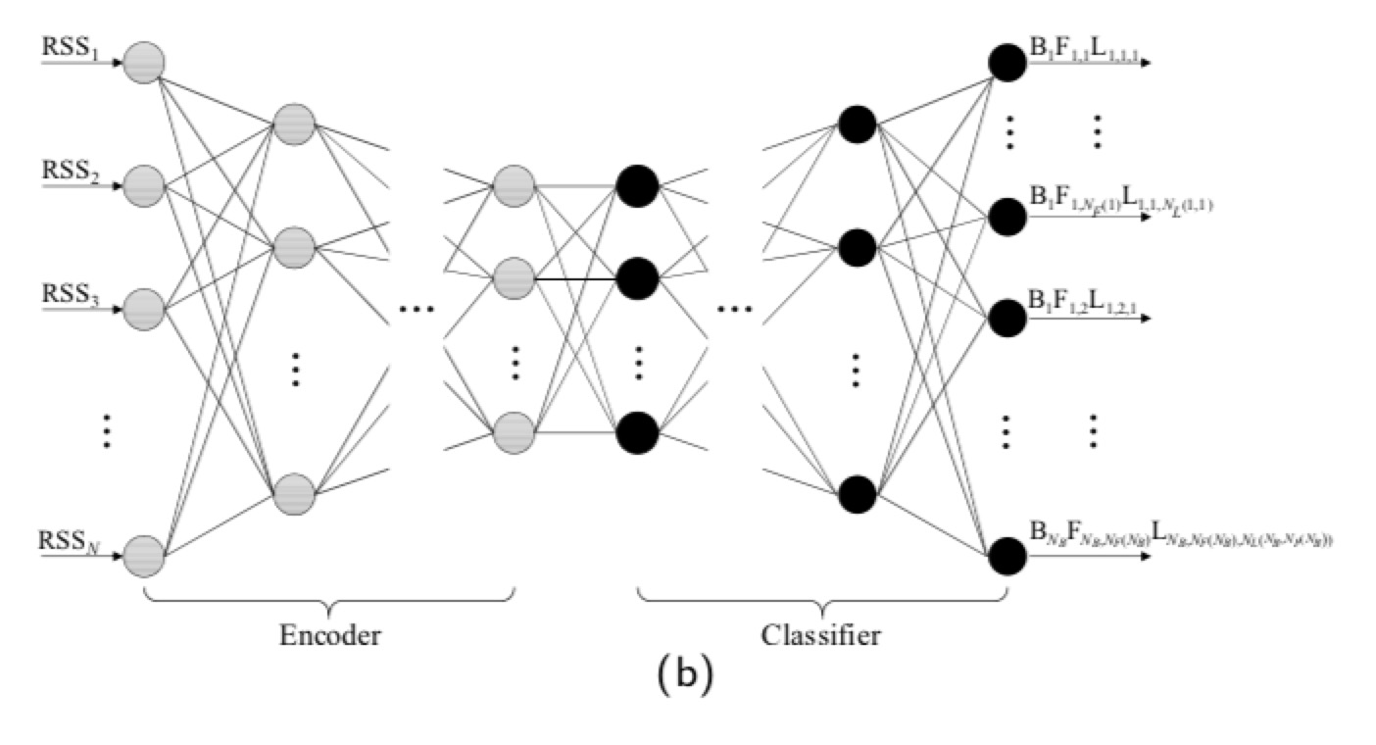
Methodology
The encoded features are then sent into a classifier for training.
11

Slide 12
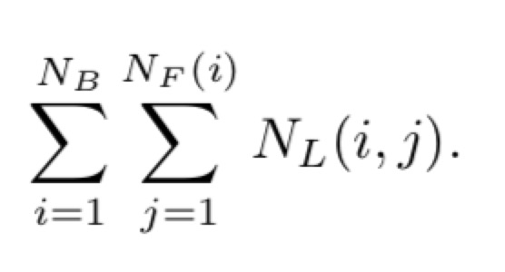
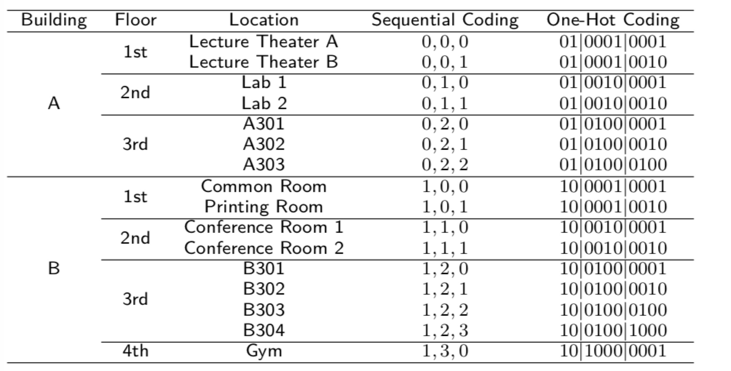
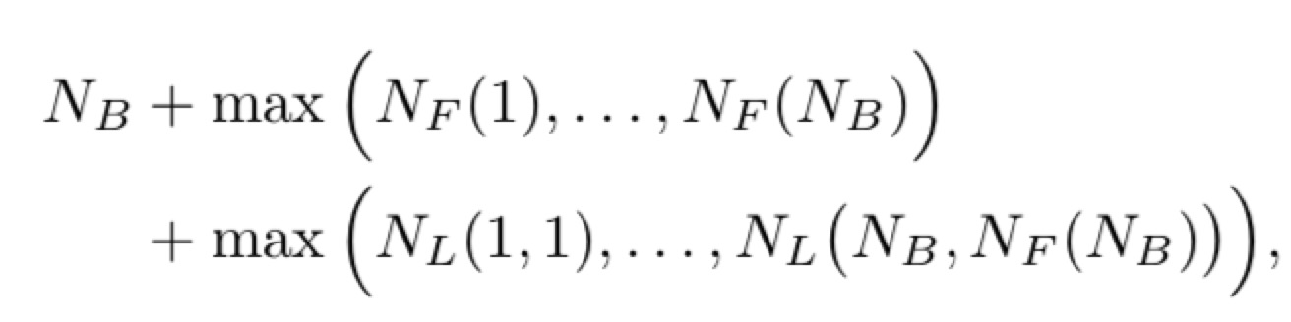
Methodology
One-Hot Coding of the location
-> reduce the number of outputs (reference locations)
-> explore the hierarchical connections between
building, floor and plane coordinates
12

Slide 13
Methodology
Estimation of the location from the output label
Estimate the building and the floor of a location as the
index of a maximum value of the
corresponding vector through the ARGMAX function.
Estimate the plane coordinates of a location according
to the following algorithm.
13

Slide 14
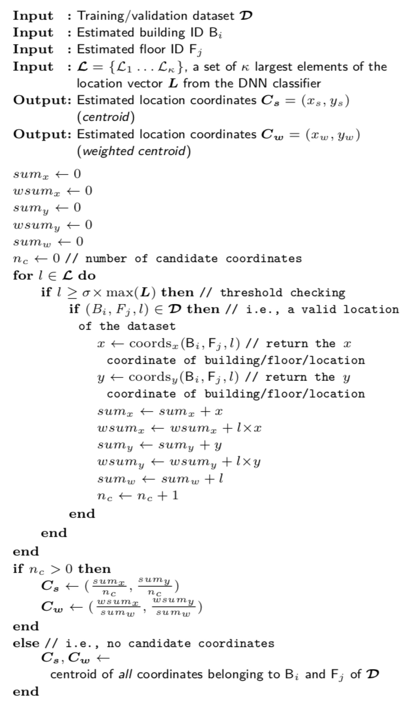
Methodology
14

Slide 15
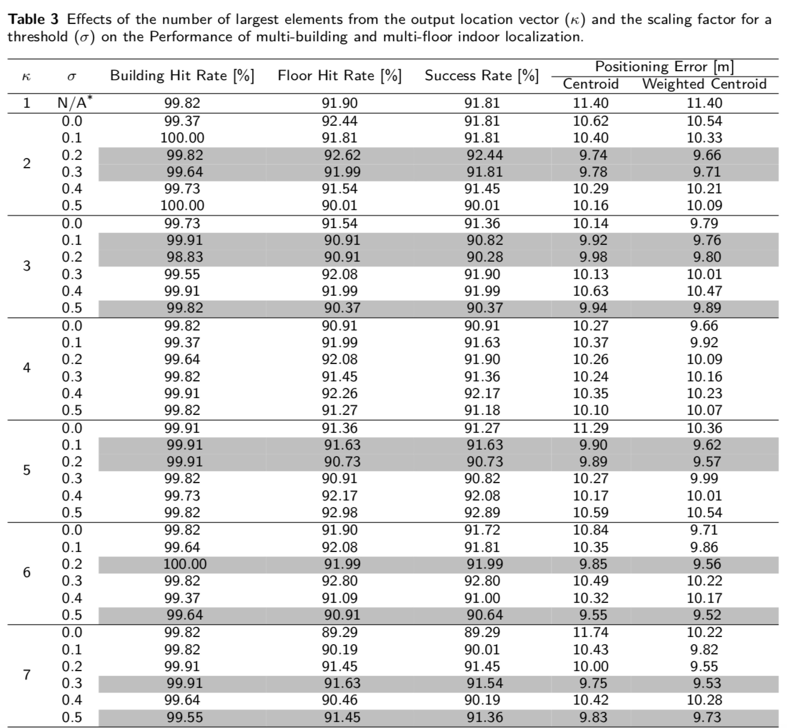
Result
15

Slide 16
Issues & Problems
Innovative points:
-> better exploit the hierarchical nature of huge buildings.
-> open a door for a future secure and energy-efficient indoor localization solution exclusively running on mobile devices without exchanging any data with the server.
More to be explored:
-> further optimization of the performance through DNN parameter tuning and the investigation of the performance and complexity tradeoff.
-> no direct match between the cost function used in DNN training/validation and the actual performance in the final evaluation for building/floor detection and the location coordinates estimation.
-> Generic Algorithms (GA) to train DNN weights.
-> Lack of data; Lack of data diversity
-> Too many Access Points
-> Time issue
16

Slide 17
Generic Algorithm
Initialize N random networks to create our population.
Score each network. Train the weights of each network and then see how well it performs at classifying the test set. [Fitness function]
Sort all the networks in our population by score (accuracy). We’ll keep some percentage of the top networks to become part of the next generation and to breed children.
We’ll also randomly keep a few of the non-top networks. This helps find potentially lucky combinations between worse-performers and top performers, and also helps keep us from getting stuck in a local maximum.
Now that we’ve decided which networks to keep, we randomly mutate some of the parameters on some of the networks.
Let’s say we started with a population of 20 networks, we kept the top 25% (5 nets), randomly kept 3 more loser networks, and mutated a few of them. We let the other 12 networks die. In an effort to keep our population at 20 networks, we need to fill 12 open spots. It’s time to breed!
17

Slide 18
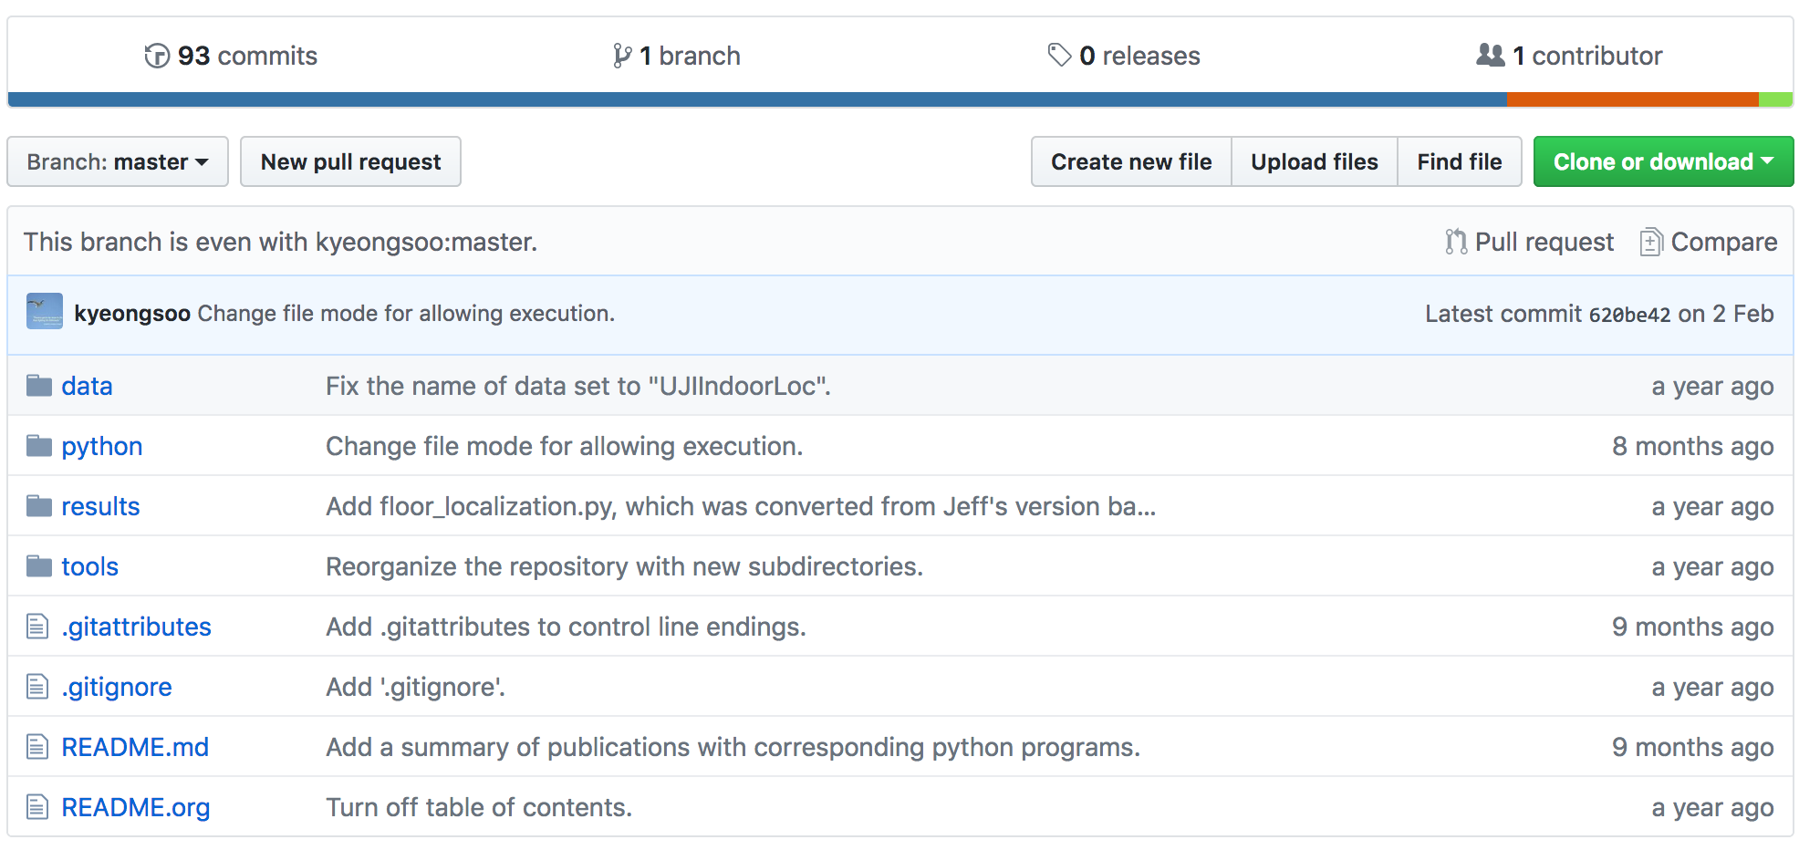
Result Reproducing
18

Slide 19
Result Reproducing
UJIIndoorLoc Dataset
Although there are many papers in the literature trying to solve the indoor localization problem using a WLAN fingerprint-based method, there still exists one important drawback in this field which is the lack of a common database for comparison purposes. So, UJIIndoorLoc database is presented to overcome this gap. We expect that the proposed database will become the reference database to compare different indoor localization methodologies based on WiFi fingerprinting.
Each WiFi fingerprint can be characterized by the detected Wireless Access Points (WAPs) and the corresponding Received Signal Strength Intensity (RSSI). The intensity values are represented as negative integer values ranging -104dBm (extremely poor signal) to 0dbM. The positive value 100 is used to denote when a WAP was not detected. During the database creation, 520 different WAPs were detected. Thus, the WiFi fingerprint is composed by 520 intensity values.
Then the coordinates (latitude, longitude, floor) and Building ID are provided as the attributes to be predicted.
19

Slide 20
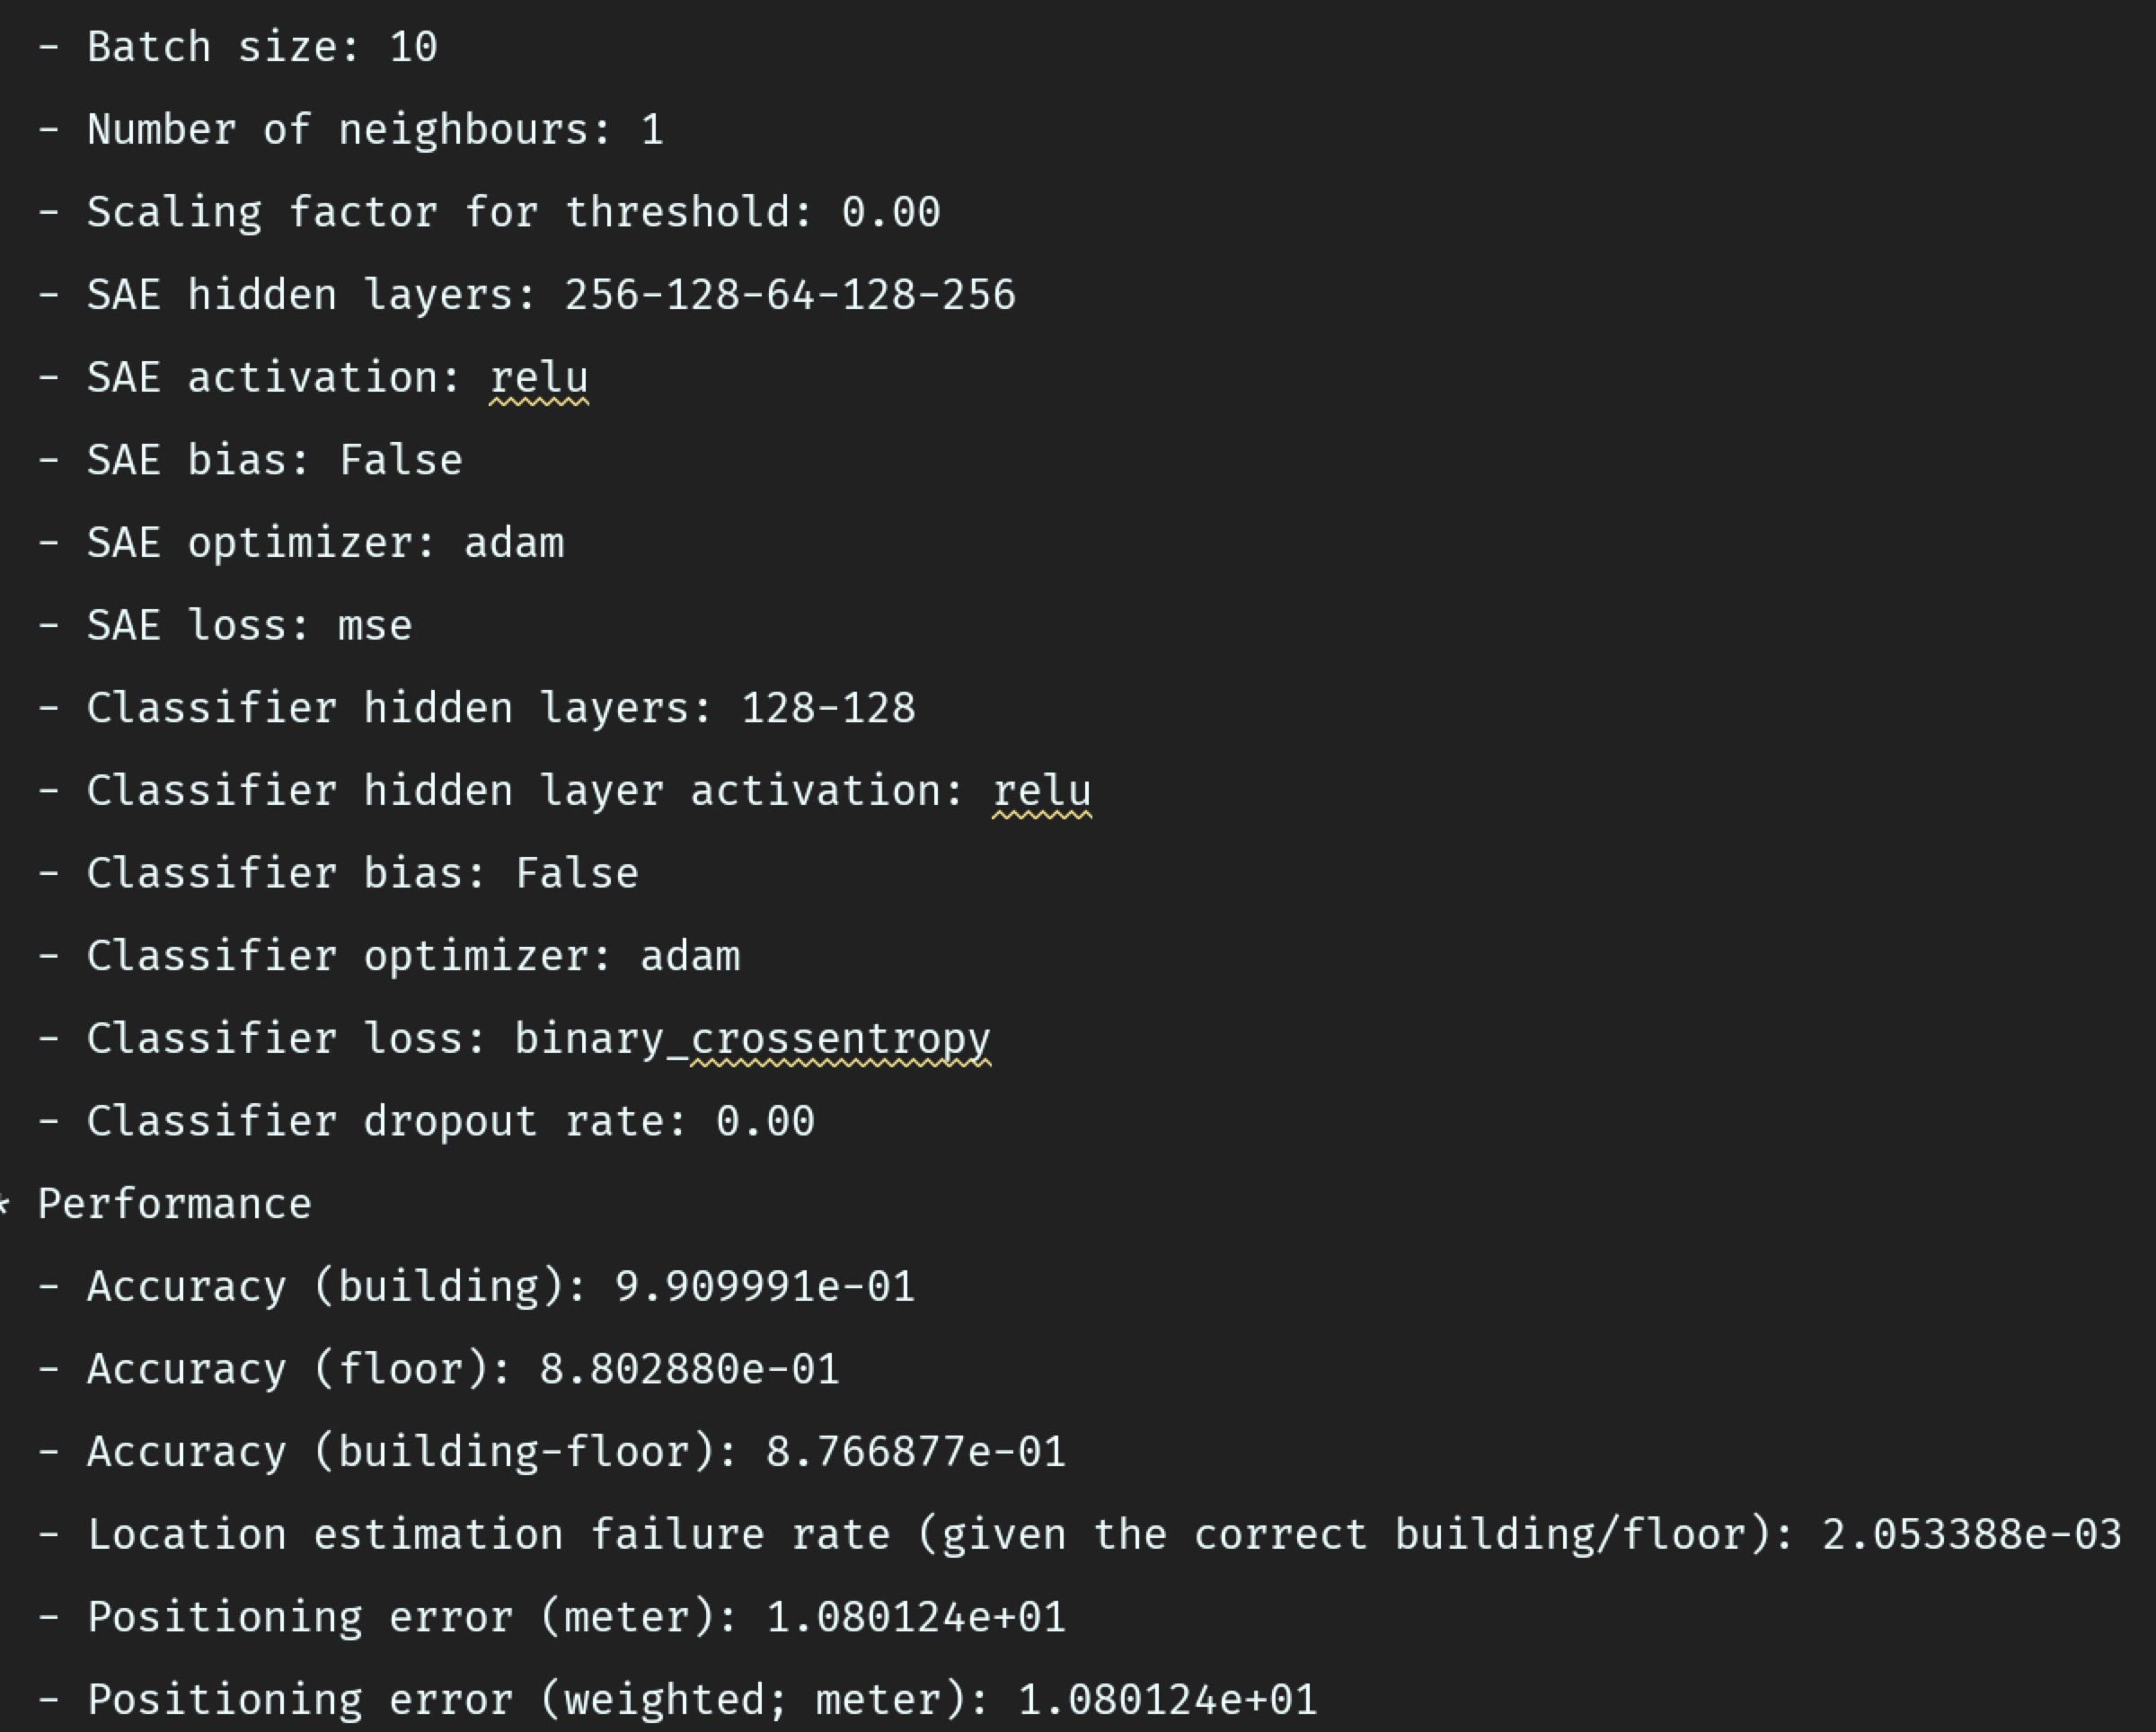
Result Reproducing
20

Slide 21
Paper [2]
Fingerprint Database Optimization Method for Indoor Localization Based on Neighbor Mean Filter
2018 7th International Conference on Agro-geoinformatics (Agro-geoinformatics)
21

Slide 22
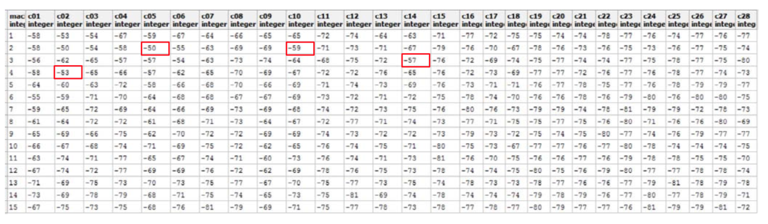
Motivation
In order to decrease the influence of original data containing bizarre RSSI possibly, filtering technology should be applied for the database. Considering the geographic correlation among RSSI values in road map, the neighbor mean filter (NMF) is introduced to optimize the fingerprint database.
22

Slide 23
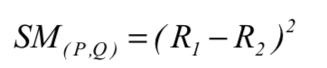
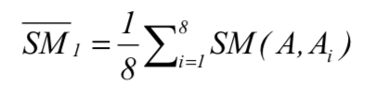
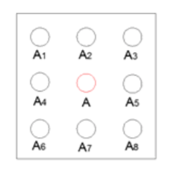
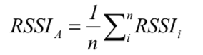
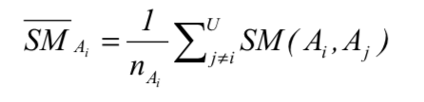
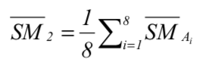
Methodology
23

Slide 24
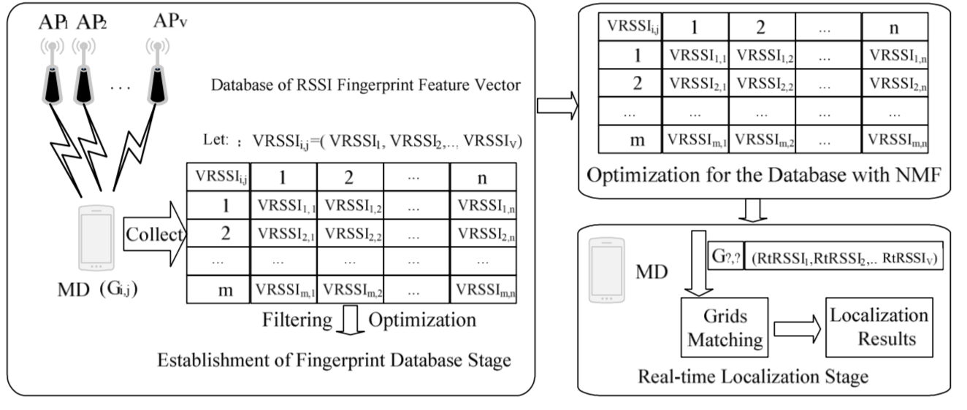
Methodology
24

